Slide 1

ESEC/FSE2022
Tracking Patches for Open Source Software Vulnerabilities
Congying XU, Chenhao LU, Bihuan CHEN, Kaifeng HUANG, Xin PENG, Yang LIU
Fudan University, China
Nanyang Technological University, Singapore
Notes:
Hi, welcome to our paper presentation.
Tracking xxx.
I cam Congying XU at FudanU, it is my great honor to work with Chenhao, Prof. Cheng bihuan, Kaifeng, Prof. Pengxin, and Prof. Liu Yang..

Slide 2
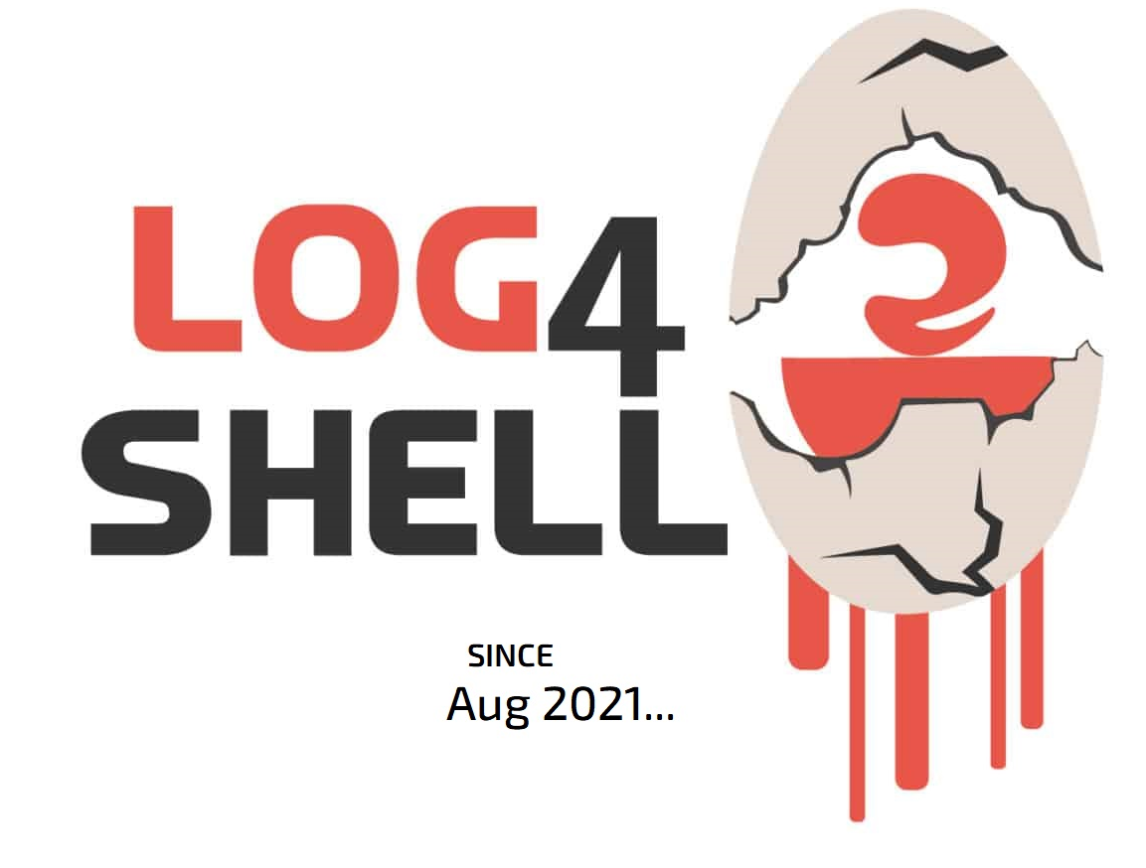

Background
OSS Security Risks
Open source software (OSS) is widely used. 98% of applications contain OSS [1].
OSS suffers from vulnerabilities, which are detected at an increasing speed [2].
Security risks are introduced with OSS (84% of applications contain at least one OSS vulnerability [1]).
cause
The Heartbleed Bug (CVE-2014-0160) [3]
Steal secret keys, passwords, communication, etc.
CVE-2021-44228
Execute arbitrary code by controlling log parameters.
[1] Synopsys, https://www.synopsys.com/content/dam/synopsys/sig-assets/reports/rep-ossra-2021.pdf
[2] Snyk, https://snyk.io/wp- content/uploads/sooss_report_v2.pdf
[3] https://heartbleed.com/
Notes:
Firstly, I want to introduce the background about OSS security risks. // 可以没有转接词。
Open source software (OSS) is widely used by many applications.
According to the report from Synopsis, 98% of applications contain OSS.
But, In the meanwhile, OSS suffers from vulnerabilities.
Alomost doubling in the last two years,..
This causes the security risks inducing by using OSS. According to the Synopsis report, up to 84% of applications contain at least one OSS vulnerability.
These vulnerabilities can cause serious security problems.
For example,
The famous heartbleed bug is from the popular library OpenSSL. Which allows attacks steal …. Commincation sata,
This vulnerability affected a lot of commercial services including Amazon Web Services,^{[12]}, and Tencent QQ.
And Log4shell is the another serious vul, which was disclosed last year.
This vulnerability allows attackers to xxx

Slide 3


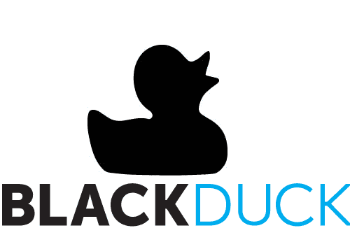




Background (cont.)
OSS Security Risks
Open source software (OSS) is widely used. 98% of applications contain OSS [1].
OSS suffers from vulnerabilities, which are detected at an increasing speed [2].
Security risks are introduced with OSS
(84% of applications contain at least one OSS vulnerability [1]).
cause
Mitigation
Vulnerability databases
enable
Vulnerability analysis tasks
software composition analysis
patch presence testing
patch generation and deployment …
Description, vulnerable versions, patches …
[1] Synopsys, https://www.synopsys.com/content/dam/synopsys/sig-assets/reports/rep-ossra-2021.pdf
[2] Snyk, https://snyk.io/wp- content/uploads/sooss_report_v2.pdf
[3] https://heartbleed.com/
Notes:
A lot of efforts have been made to mitigate security risks in OSS vulnerabilities.
Vulnerability databases play a significant role in enabling various vulnerability analysis and security tasks.
CVE List [15] and NVD [21] are well-known public vulnerability databases,
And there are many industrial vulnerability databases, such as xxx, xx, xx, .
By providing valuable information (e.g., description, vulnerable versions, and patches) security engineers can do the SCA to identify vulnerable libraries and fix it.
other security tasks , such as patch presence testing, and patch presence testing can also be supported by these vul DBs.

Slide 4


Problem
It is unclear what the quality of patches in vulnerability database is.
Patch:
dd5a7c@moped
2015-4410
Patch:
976da3@bson-ruby
2. Existing patch tracking approaches are either too expensive or too specific to apply to all OSS vulnerabilities.
Notes:
However, the problem is, it is unclear what the quality of patches in vulnerability database is.
Example:for CVE-2015-4410
In Ve, the provided patch is xxx
However, in S,
The provided patches are inconststent.
Does that mean one of them is inoccrect? Or boththe teo patches are all correct? We need to research and have the answer.
No existing works research the the quality of patches in vulnerability database is.
Besides,
These patch tracking approaches are either too expensive by manual effort to collect
or too specific by mining specific repositories to idenfy the patches
These approaches cannnot be applied to all OSS vulnerabilities.
然而, 作为一切深度安全分析任务的基础，已有的漏洞数据库中的补丁知识尚未被系统 地研究和评估
此外，已有的补丁查找方法多是基于启发式规则、挖掘代码提交历史或人工查找，
，
本文研究内容主要有两块：
1. 针对开源软件漏洞补丁的经验研究，以了解当前商业漏洞数据库中补丁的质量和特征。
2. 基于经验研究的结果，设计一种自动化的补丁查找方法，并进行实验评估。

Slide 5
Our Goals
Problem
It is unclear what the quality of patches in vulnerability database is.
Existing patch tracking approaches are either too expensive or too specific to apply to all OSS vulnerabilities.
……
Our Goals
Study the quality and characteristics of OSS vulnerabilities patches in industrial databases.
An empirical study
Tracer
Propose an approach to automatically track patches.
Notes:
Considering the two problems, in this paper, our goals are to xx by conducting ….
And prose … To track patches for xxx .
The proposed approach is call tracer.

Slide 6
Empirical Study
Notes:
Here
Let’s go to the empirical study section.

Slide 7




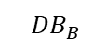
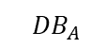
Empirical Study Design
Goal
Study the quality and characteristics of OSS vulnerabilities patches in industrial databases.
Data Preparation
Research Questions
RQ1 Coverage Analysis
RQ2 Consistency Analysis
RQ3 Type Analysis
RQ4 Cardinality Analysis
RQ5 Accuracy Analysis
10,070 Vul.
=
+
$${DB}_{A}$$
$${DB}_{B}$$
1295 Vul.
=
Ground Truth
Vul. with patches
Notes:
To study the the quality and characteristics of OSS vulnerabilities patches in industrial databases.
We answer the following 5 RQs.
We design RQ1 to measure the prevalence of missing patches for OSS vulnerabilities in different vulnerability databases.
We use RQ2 to quantify the prevalence of inconsistent patches for OSS vulnerabilities across different vulnerability databases.
We leverage RQ3 and RQ4 to capture the common patch types and mapping cardinalities between OSS vulnerabilities and their patches. W
e develop RQ5 to assess the accuracy of patches for OSS vulnerabilities in different vulnerability databases.
During the data preparation,
Initially, we selected the vulnerability databases from 5 popular companies. These companies provide software composition analysis service to identify OSS used in an application and report any OSS vulnerabilities. So we think their dbs may have good coverage of OSS vulnerabilities .
However, during further investigation, we found that some of them do not make their db public accessible. Or do not make the patch information publicly accessible.
finally we selected Veracode’s and Snyk’s vulnerability databases. Which is publicly accessible and containing patches of vulnerabilities.
In the following sec, we call them Dba and DBb.
From these two DBs, we collected 10,0070 vul. , and to do the coverage and consistency analysi.
Based on the collected 10,079 vul., we manually identified patches for 1295 vuls. This is the gound truth for type analysis, cardinality, accuracy analysis.
From these two DBs, we collected 10,0070 vul. , and to anser RQ1 and Rq2. by analyzing the vul coerver with patches, and checking the consistency of patches provided by two DBs.
Based on the collected 10,079 vul., we manually identified patches for 1295 vuls. This is the gound truth for type analysis, cardinality, accuracy analysis.

Slide 8
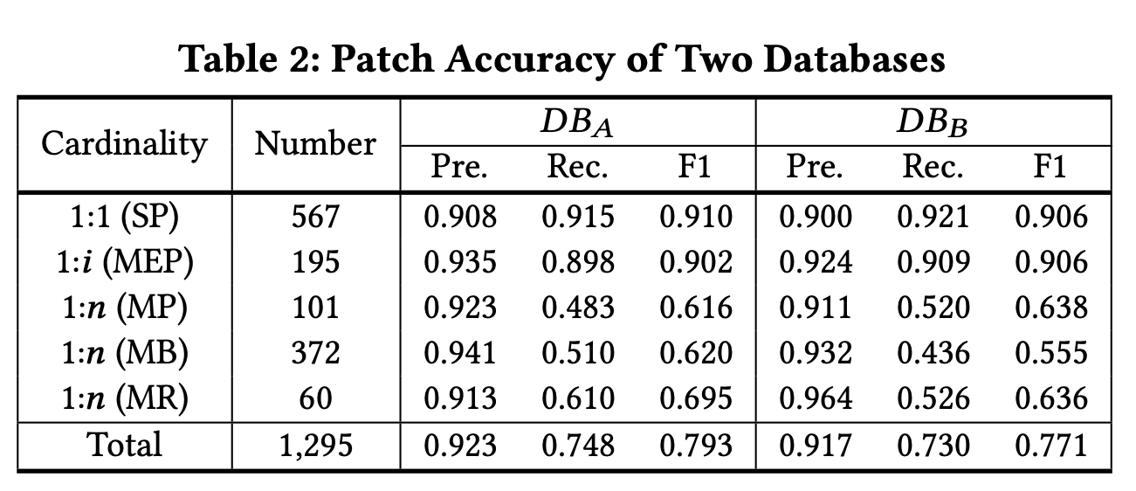
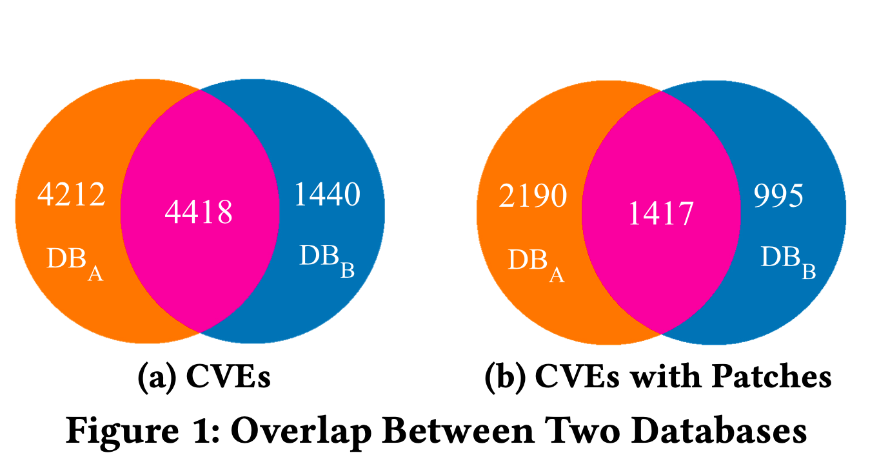
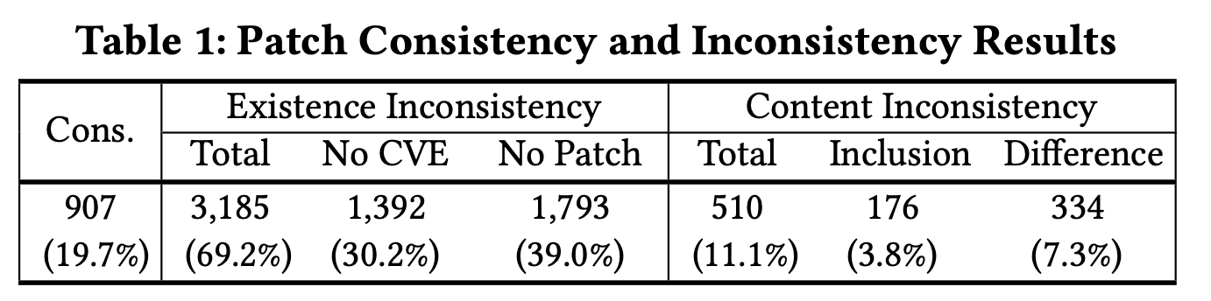
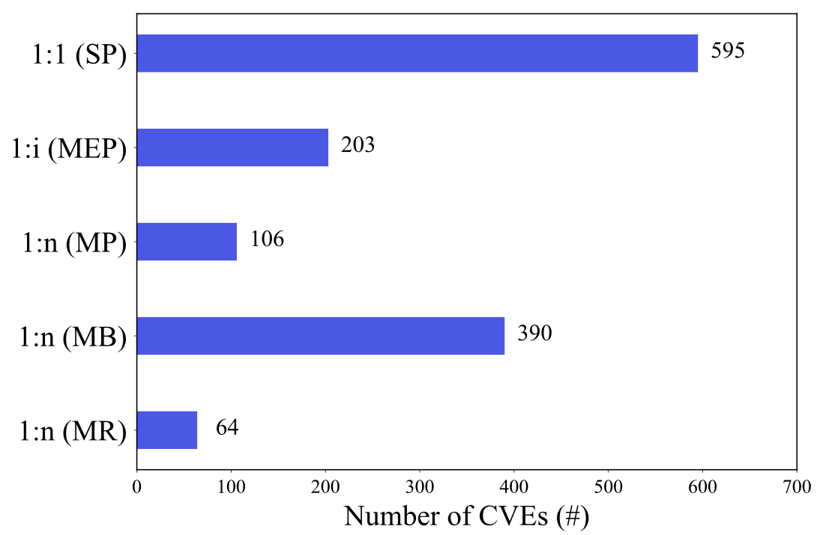
Empirical Study Results
Quality of patches in industrial ${DB}_{A}$ and ${DB}_{B}$
RQ1 Coverage Analysis
RQ2 Consistency Analysis
RQ5 Accuracy Analysis
45.7% of 10070 CVEs are with patches.
19.7% of CVEs have consistent patches in two databases.
Having a high precision (0.9), but a low recall (0.5) for CVEs with multiple patches.
10070
4602
Characteristics of OSS vulnerabilities patches
RQ3 Type Analysis
Above 90% of patches are the GitHub commits
Necessity: Automatically track complete patches for OSS vulnerabilities.
CVE with single patch
Challenge: Effectively track complete patches
RQ4 Cardinality Analysis
41.1% (533/1295) of CVEs with multiple patches.
CVE with multiple patches
Notes:
Here is the empirical study result.
For the quality of patches, in the RQ coverage analysis,
in the RQ2, consistency analysis,
In the RQ5, both
The coverage, and accuracy of patches in two DBs is not high around 50% and 0.7. This indicates the necessity of tracking ..
As to the characteristics,
We find that above 90% of patches are in the form of GitHub commit.
This indicates the challenge of …

Slide 9
Approach
Notes:
Next, Let me introduce our proposed approach Tracer.

Slide 10

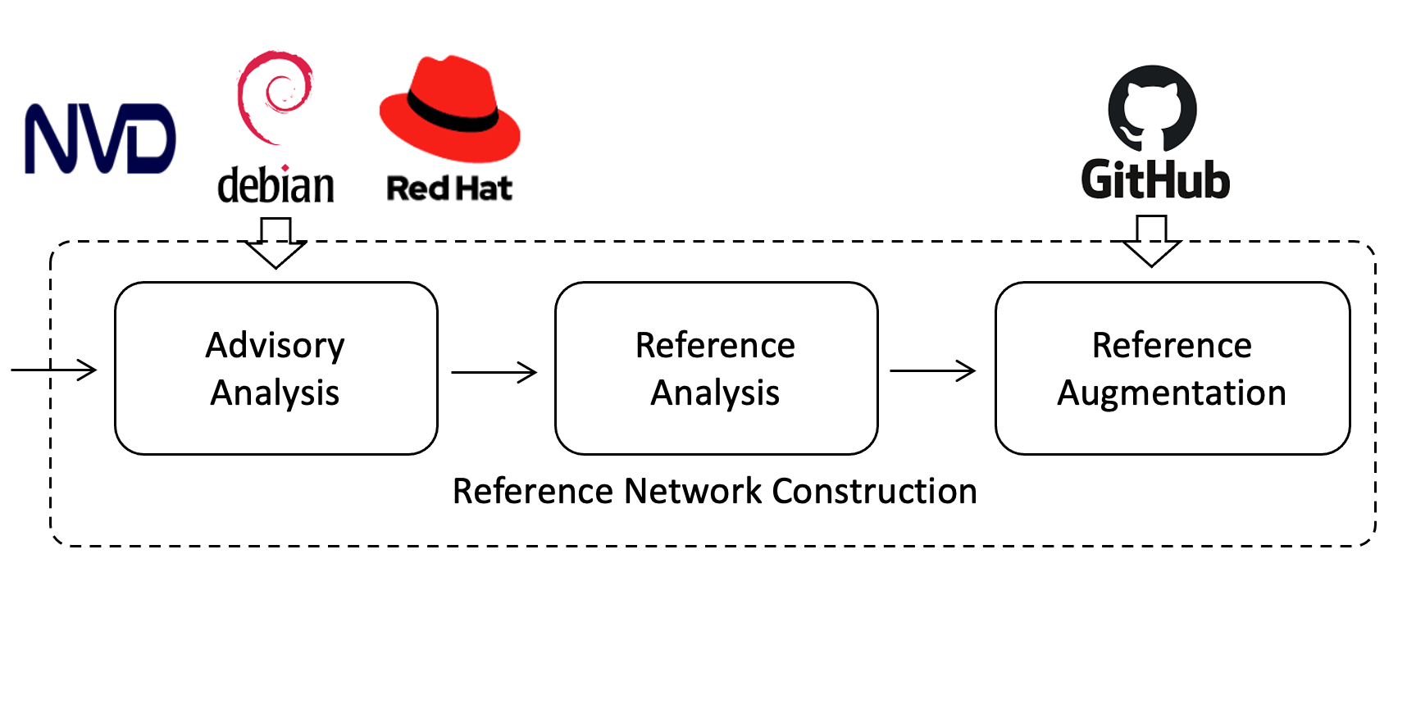
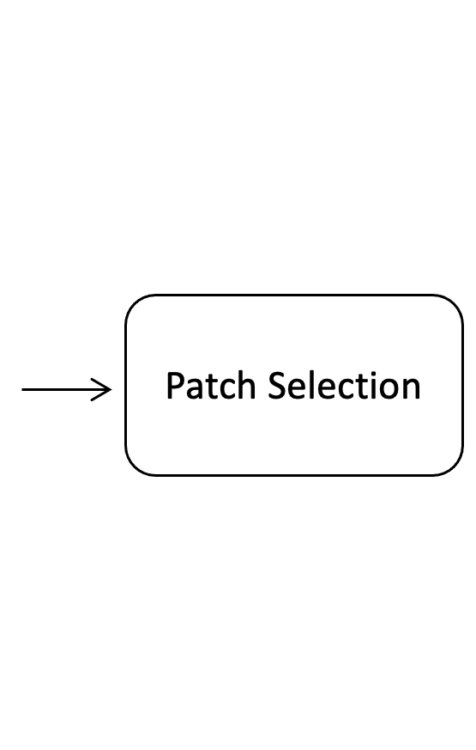
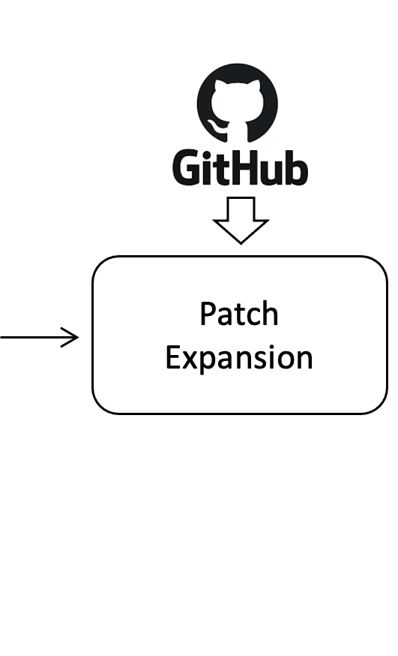
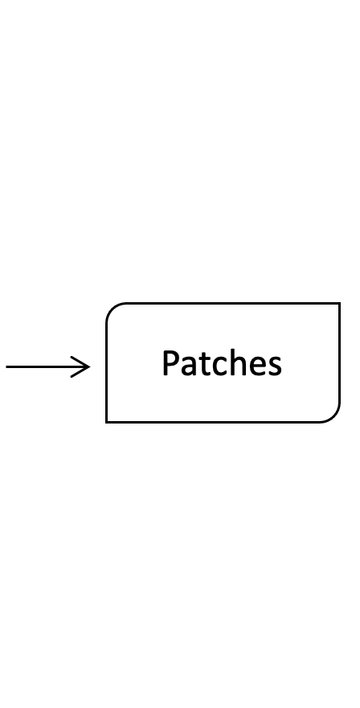
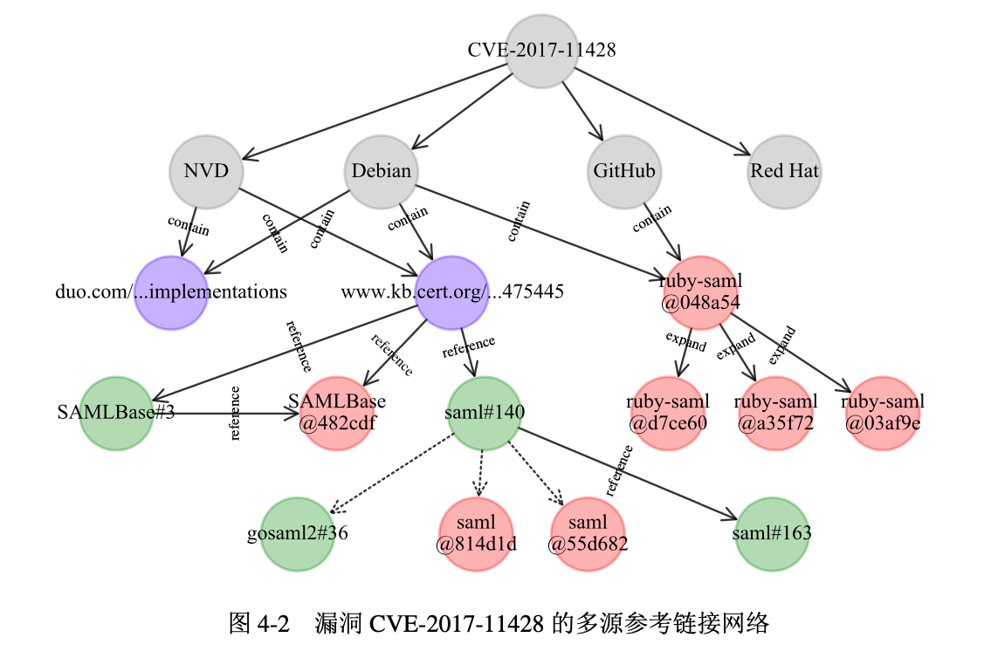
Approach of Tracer
Key Idea: Patch commits are often frequently referenced during the reporting, discussion and resolution of an OSS vulnerability.
Approach Overview
Example
CVE-2017-11428
Notes:
During the manual investigation, we find that xxx .
And this is the key idea of our approach..
Tracer works in three steps.
Firstly, it takes the CVE identifier of an OSS vulnerability as input, and constructs a reference network based on multiple knowledge sources, including NVD, Debian, and redhat. , this step is to model references during vulnerability reporting, discussion and resolution.
Second, it selects patch commits in the network that have high connectivity and high confidence.
Finally, based on selected patch commit. it expands the selected patch commits by searching relevant commits across branches of a repository so as to completely track patches.

Slide 11
Evaluation

Slide 12
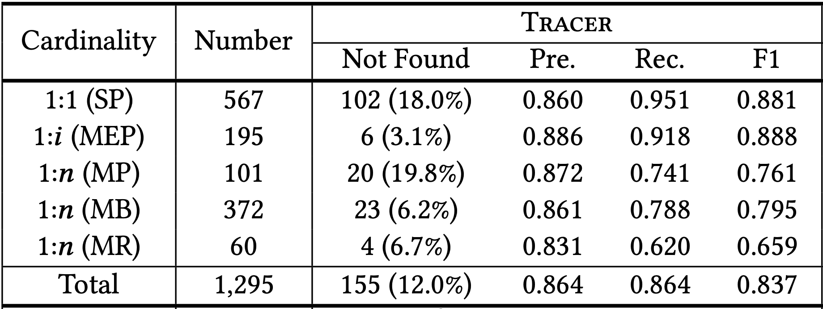
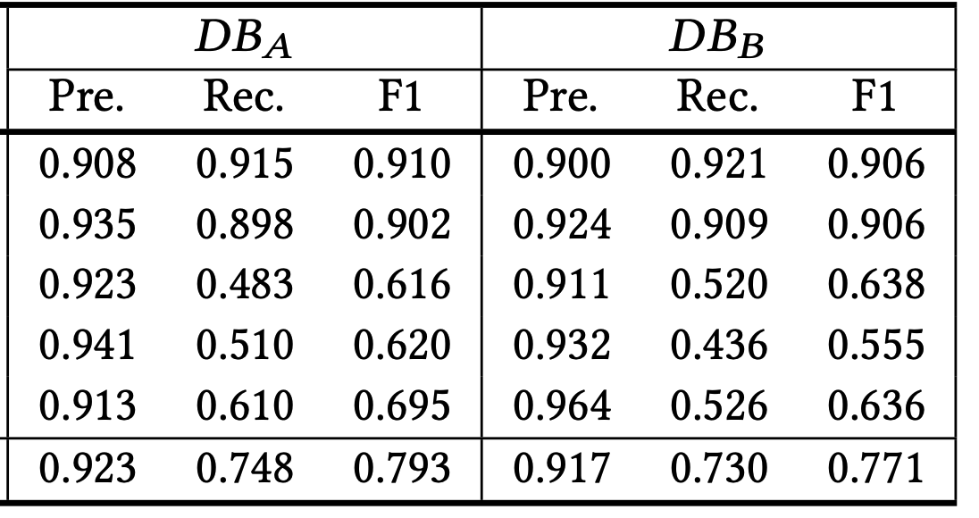
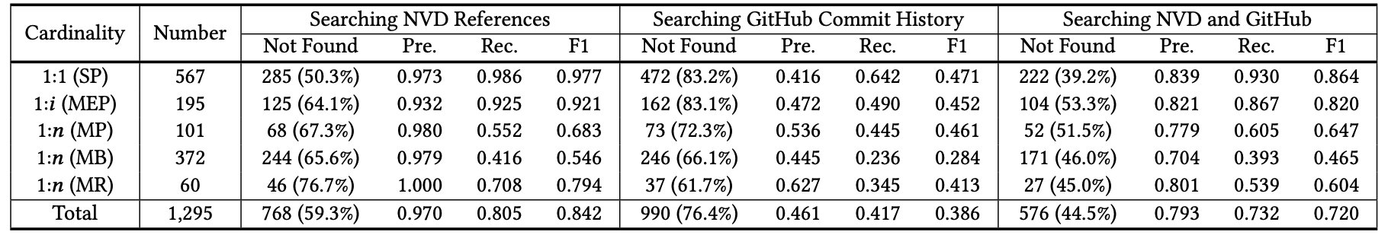
Evaluation Results
RQ6 Effectiveness Evaluation
How is the effectiveness of Tracer in tracking patches?
Compared to industrial databases, Tracer achieves a 18.4% higher recall and a 8.6% higher F1-score.
Compared to existing heuristics, Tracer finds patches for 58.6% ~ 273.8% more vulnerabilities.
Tracer can complement industrial vulnerability databases by reducing manual effort and tracking patches completely.
Notes:
In the evaluation,
we do the effectiveness evaluation first, and answer how is the effectiveness of Tracer in tracking patches, compared to two industrial vulnerability databases and existing heuristic-based approaches?
Compared to industrial databases, Tracer achieves a 15.5% to 18.4% higher patch recall and a 5.5% to 8.6% higher F1-score.
Compared to existing heuristics, Tracer finds patches for 58.6% ~ 273.8% more vulnerabilities.
This indicates Tracer can complement industrial vulnerability databases by reducing manual effort and tracking patches completely.

Slide 13
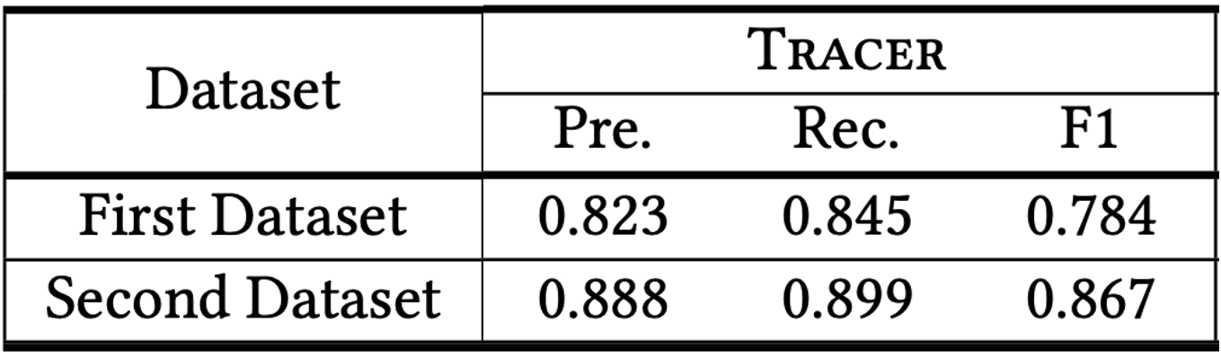
Evaluation Results (cont.)
RQ8 Generality Evaluation
How is the generality of Tracer to OSS vulnerabilities beyond our depth dataset?
Larger Dataset
First new dataset contains 3,185CVEs, for which either ${DB}_{A}$ or ${DB}_{B}$ is without patches.
Second new dataset contains 5,468 CVEs, for which both ${DB}_{A}$ and ${DB}_{B}$ are without patches.
Result
First dataset, 67.7% of CVEs patches are tracked.
Second dataset, 51.5% of CVEs patches are tracked.
The accuracy:
Tracer is generalizable and complements industrial databases.
Notes:
we do the generality evaluation, and answer how is the generality of Tracer to OSS vulnerabilities beyond our depth dataset?
To evaluate the generality of Tracer (i.e., whether Tracer is overfit- ted to our depth dataset), we collect two new vulnerability dataset and run Tracer.
The first new dataset contains 3,185CVEs, for which either ${DB}_{A}$ or ${DB}_{B}$ is without patches.
The second new dataset contains 5,468 CVEs, for which both ${DB}_{A}$ and ${DB}_{B}$ are without patches.
For the first dataset, 67.7% of CVEs patches are tracked.
For the second dataset, 51.5% of CVEs patches are tracked.
Then, we sample 100 CVEs for which Tracer finds patches ,and manually measure the accuracy.
The results show , two new datasets with a sampled patch precision of 0.823 and 0.888

Slide 14
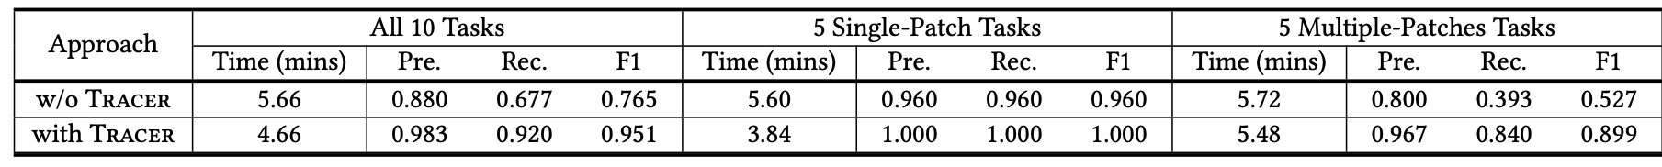
Evaluation Results (cont.)
RQ9 Usefulness Evaluation
How is the usefulness of Tracer in practice?
User Study
10 participants: they are Postdocs, PhD students, master students, and engineers majoring in software security.
Task: find patches for 10 CVEs with and without the help of Tracer.
Result
With Tracer, the time was save by 17.7%, and F1-score improved by 24.3%.
Tracer is useful in practice for security experts to localize patches more accurately and quickly.
Notes:
In practice, to ensure patch accuracy, security experts still need to verify patches even when automatic tools are used to find patches.
So, we do the Usefulness Evaluation, to answer how is the usefulness of Tracer in practice.
we conducta user study with 10 participants They are Postdocs, PhD students, master researchers, and engineers majoring in software security.
They are required to find patches for 10 CVEs with and without the help of Tracer
The result shows, With Tracer, the time was save by 17.7%, and F1-score improved by 24.3%.
This means: Tracer is useful in practice for security experts to localize patches more accurately and quickly.

Slide 15
Conclusions
Conducted an empirical study to understand the quality and characteristics of patches for OSS vulnerabilities in two industrial vulnerability databases.
Proposed Tracer to track patches for OSS vulnerabilities.
Extensively evaluated the effectiveness, generalization and usefulness of Tracer.
The code and data are available at https://patch-tracer.github.io.
Notes:
Ok, in conclusion,
In this paper, we conducted …

Slide 16
ESEC/FSE2022
Thanks for your attention!
Tracking Patches for Open Source Software Vulnerabilities
Congying XU, Chenhao LU, Bihuan CHEN, Kaifeng HUANG, Xin PENG, Yang LIU
Fudan University, China
Nanyang Technological University, Singapore
Notes:
That’s all.
Thanks a lot for your attention.

